Slide 1
Ingress & Healthy Life
Global study and collaboration
team 555
Choong wei xian 1ay15003
Peeranut manokhan 1 ay15011

Slide 2
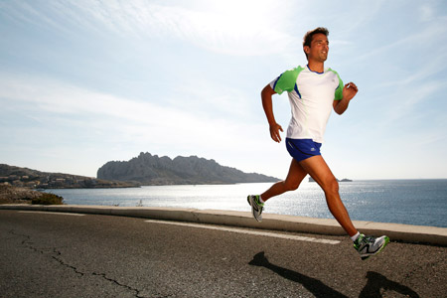
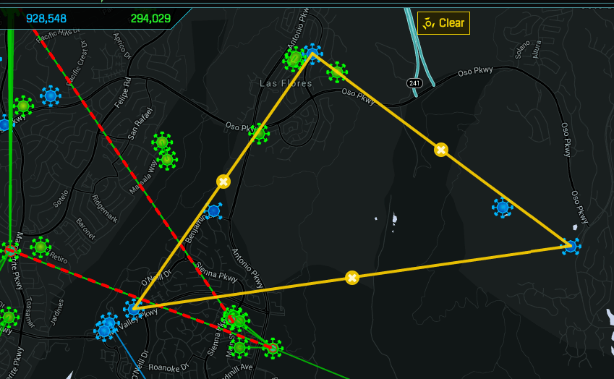
How to become Healthier ?
Use the Ingress for Marathon or Jogging
Use a Portal as “Check Point”

Slide 3
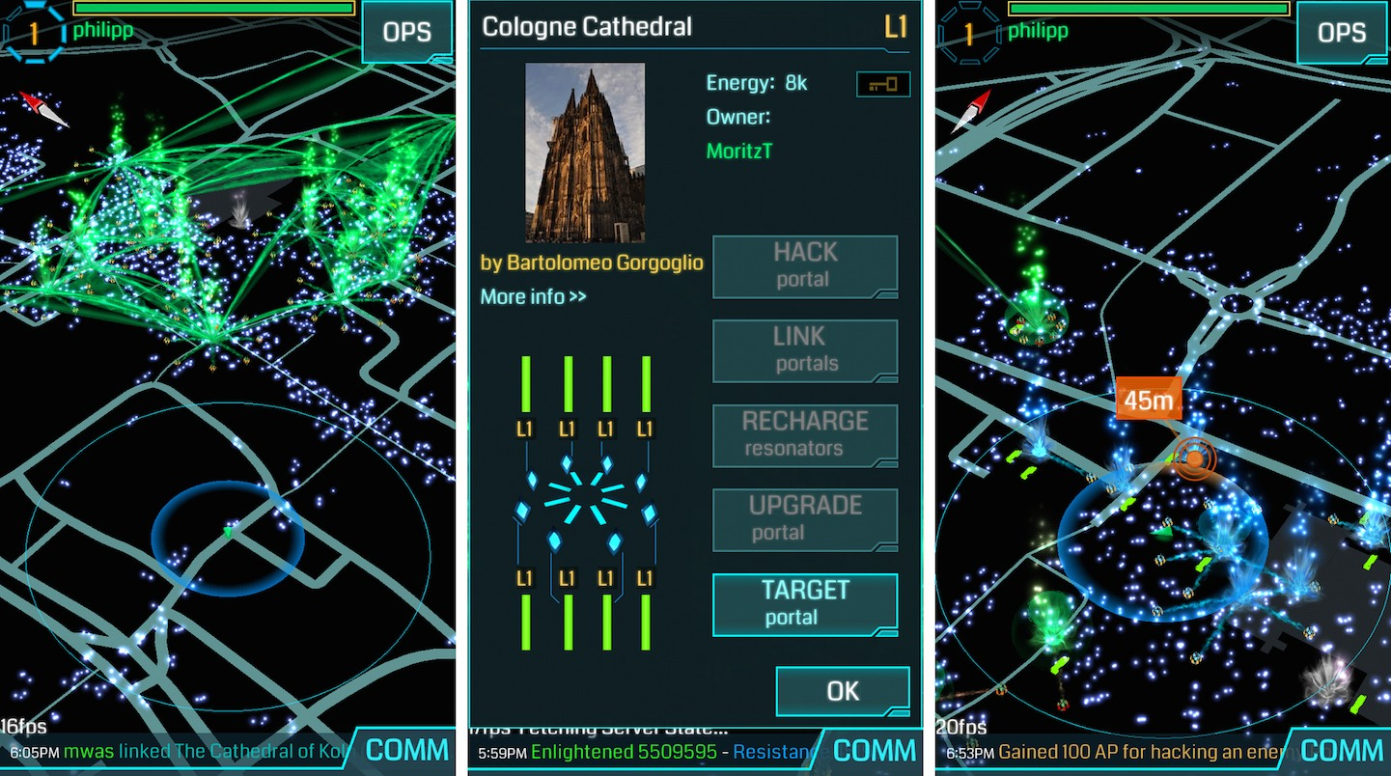
Use the GPS to locate the location of the people
Use the GPS to collect data about the statistics of those participants

Slide 4
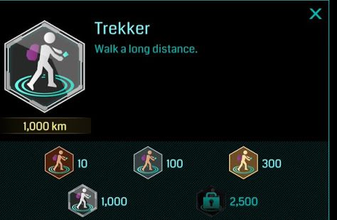
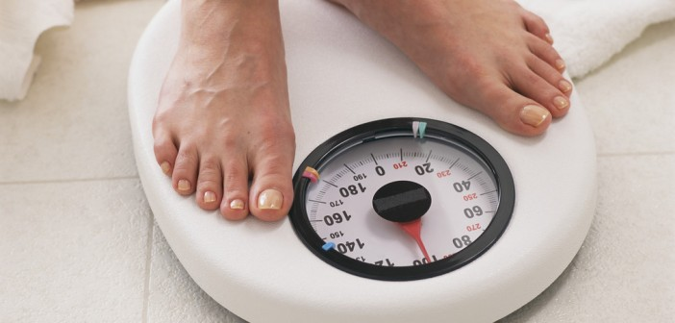
Can use data from ingress to calculate in program for weight loss
Determine the suitable program for others from the data collected in corresponding measure

Slide 5
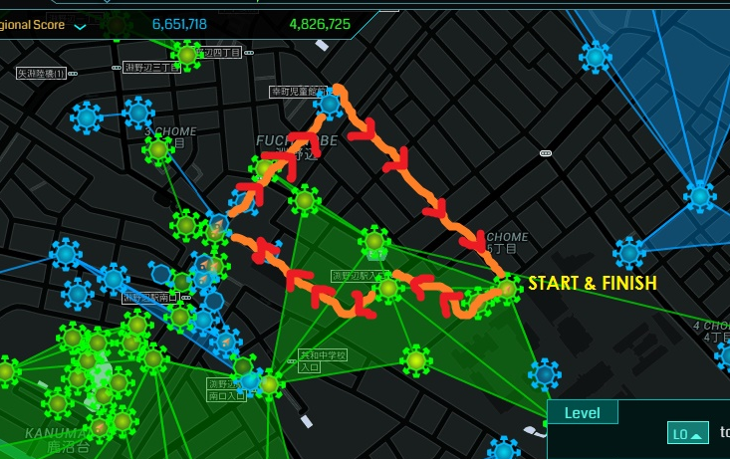
Let’s try
Let’s jogging around Fuchinobe

Slide 6
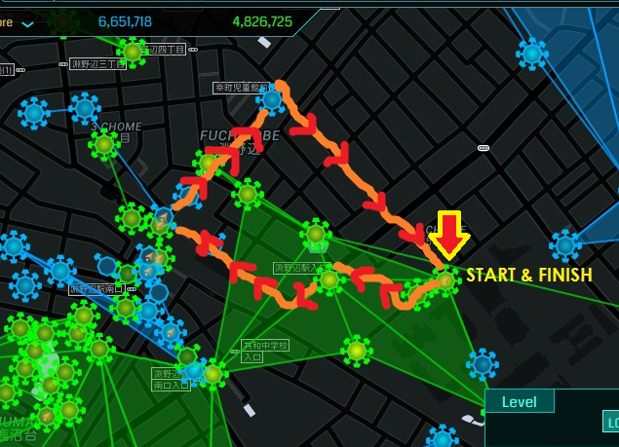
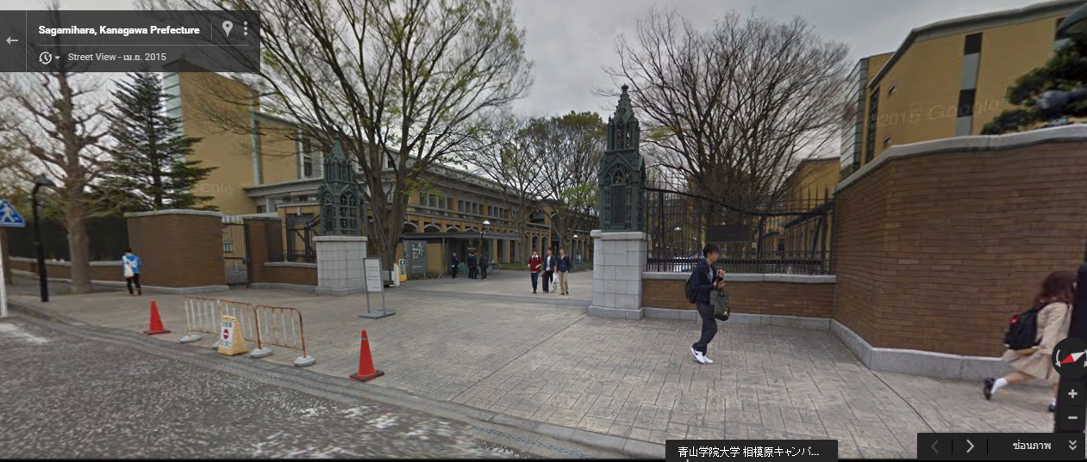
Start & Finish
Start From Aoyama Gakuin University Sagamihara campus Main Gate

Slide 7
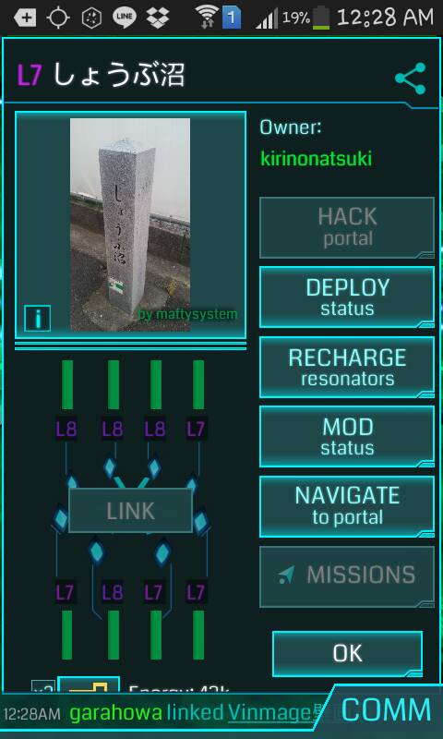

First CheckPoint
Name : しょうぶ沼
Distance From Start Point : 200 m.
Total Distance : 200 m.

Slide 8
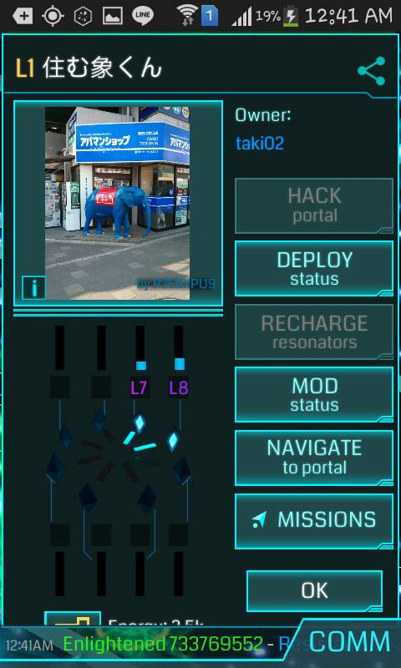
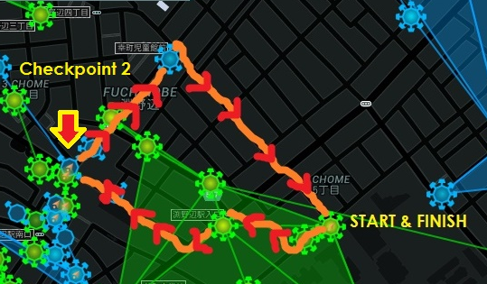
Checkpoint 2
Name : 住む象くん
Distance From Checkpoint 1 : 450 m.
Total Distance : 650 m.

Slide 9
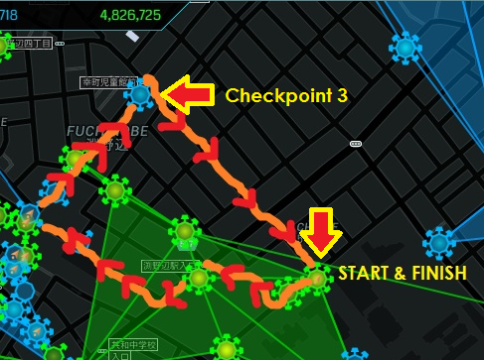
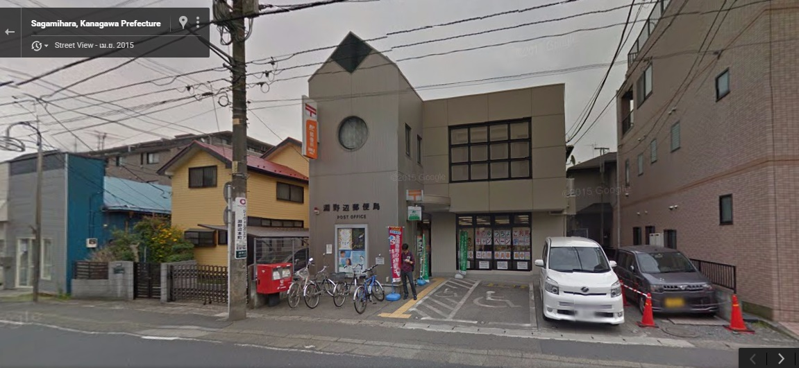
Checkpoint 3
Name : 淵野辺郵便客
Distance From Checkpoint 2 : 300 m.
Distance To Finish point : 550 m.
Total Distance : 1,500 m.

Slide 10
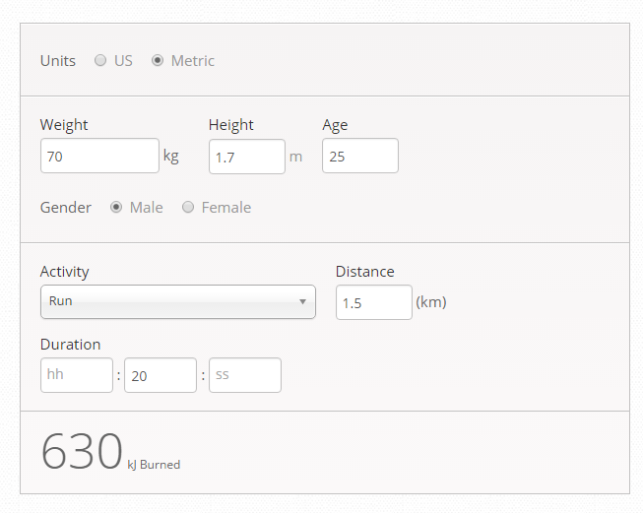
After Jogging
Use the data from ingress to calculate calories burn from this website
http://www.mapmyrun.com/improve/calorie_calculator/

Slide 11

Thank you for Attention

